Slide 1

Templates &
Presentation Layer
www.softclub.tj

Slide 2

Django Templates
• Templates
• Static Files
• Template Views
We will work with templates in Django.
Templates are used to show data as HTML pages.
We will also work with static files and template views.
www.softclub.tj

Slide 3
Templates
  HTML files used by Django
  Display data to users
  Work together with views
In Django, templates are HTML files.
They are used to show data to users.
Templates do not contain business logic.
Views send data, templates display it.
www.softclub.tj

Slide 4
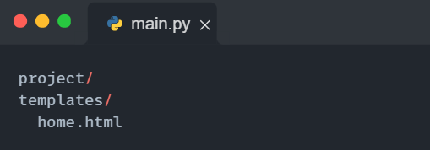
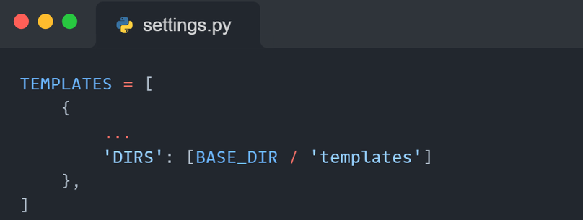
Creating a Template
• Create an HTML file
• Place it inside templates folder
• Django loads templates automatically
A Django template is just an HTML file.
We create it like a normal HTML page.
The only requirement is its location.
www.softclub.tj

Slide 5
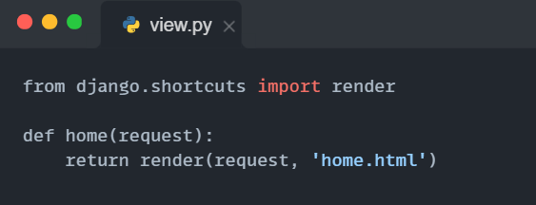
Passing Data to Templates
  View selects a template
  Django renders the template
  Result is sent to the browser Templates are not used directly.
Django uses views to render templates.
A view chooses a template and sends it to the browser.
www.softclub.tj

Slide 6
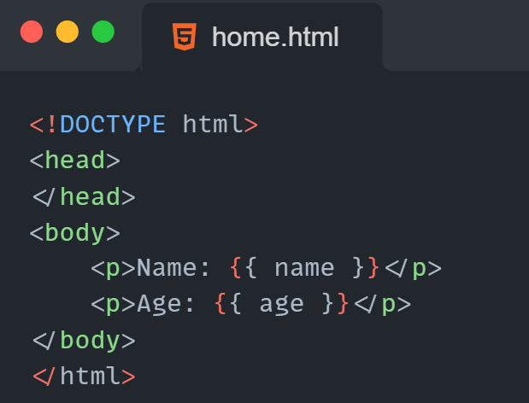
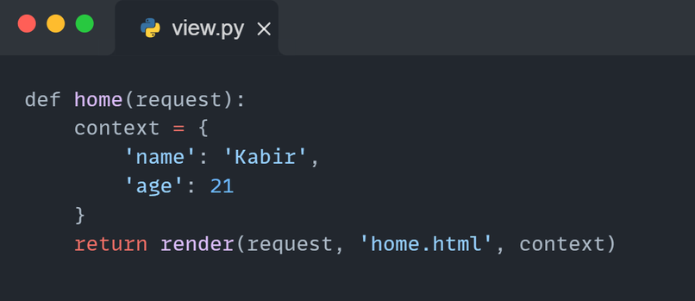
Built-in Template Tags
• Views prepare data
• Data is sent as a dictionary
• Templates display the data
Templates become useful when they receive data.
Views prepare data and send it to templates.
This data is sent as a dictionary.
www.softclub.tj

Slide 7
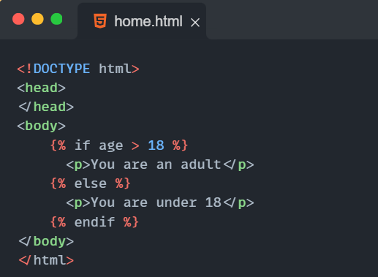
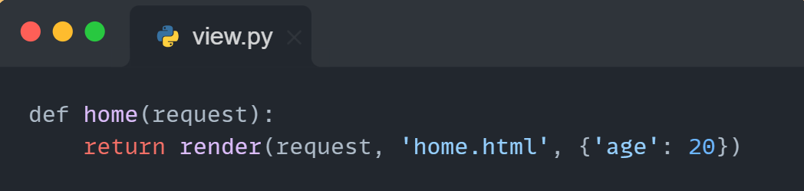
Built-in Template Tags
• Control what is shown
• Use if and for
• Written using {% %}
Sometimes we want to show different content.
Django templates use tags for this.
The most common tags are if and for.
www.softclub.tj

Slide 8
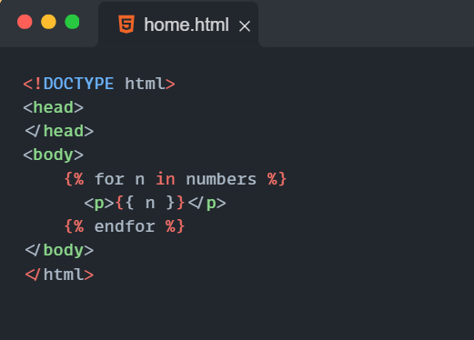
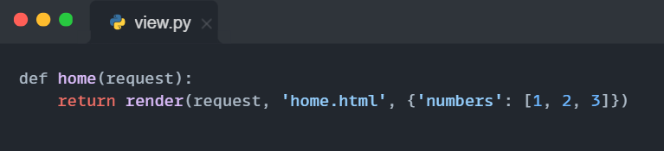
Continue
www.softclub.tj

Slide 9
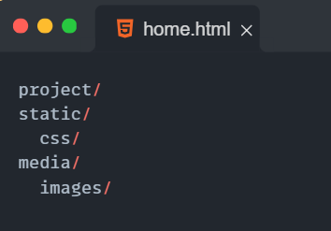
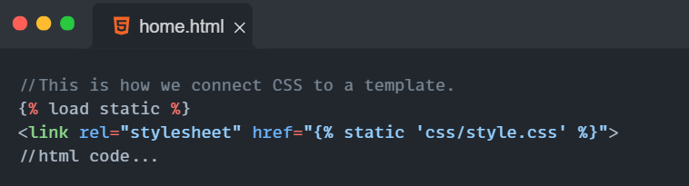
Static and Media Files
• Static: CSS, JS, images (design)
• Media: user uploaded files
• Used inside templates
Static files are added by the developer.
Media files are added by the user
www.softclub.tj

Slide 10
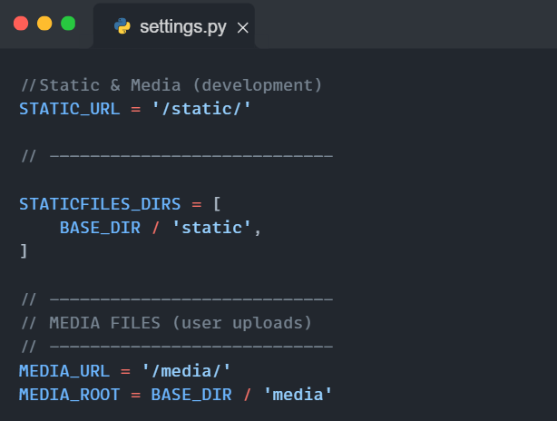
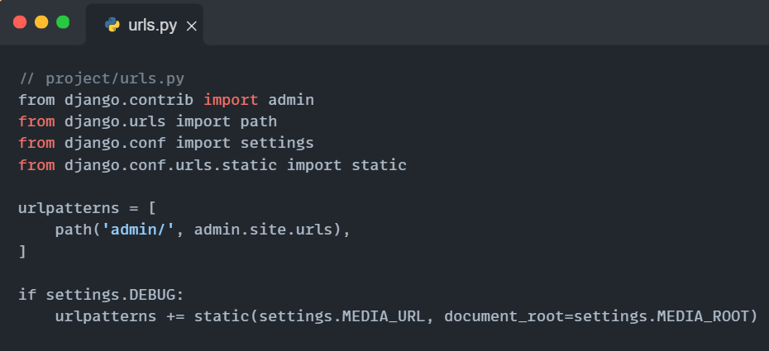
Connect static and media in settings
www.softclub.tj

Slide 11
Summary
  Templates display HTML pages
  Views send data to templates
  Template tags control logic
  Filters format output
  Static and media files handle design and uploads
  TemplateView is used for simple pages
Editional recource HERE
www.softclub.tj

Slide 12
Home Work
  1. Create a templates folder
  2. Create base.html and home.html
  3. Use TemplateView or function-based view
  4. Pass data from view to template
  5. Use if and for in the template
  6. Connect one static CSS file
www.softclub.tj

Slide 13

www.softclub.tj

